Slide 1
ACCIDENT
DATA MANAGEMENT & BIG DATA
HOTSPOT ANALYSIS
48,176
Hourly Records
Metro Interstate I-94 · Minneapolis–Saint Paul, MN
Westbound I-94 · ATR Station 301 · October 2012 - September 2018
6 Yrs
Hotspot: Any hour ≥ 4,933 vehicles (75th percentile) = HIGH RISK
2012 - 2018
I-94 carries some of the highest traffic in the Upper Midwest. This analysis identifies WHEN and UNDER WHAT CONDITIONS traffic becomes dangerously high.
25%
Hotspot Rate
Submitted by:
Dhrumil Shaileshkumar Khalas
Source: UCI Machine Learning Repository

Slide 2
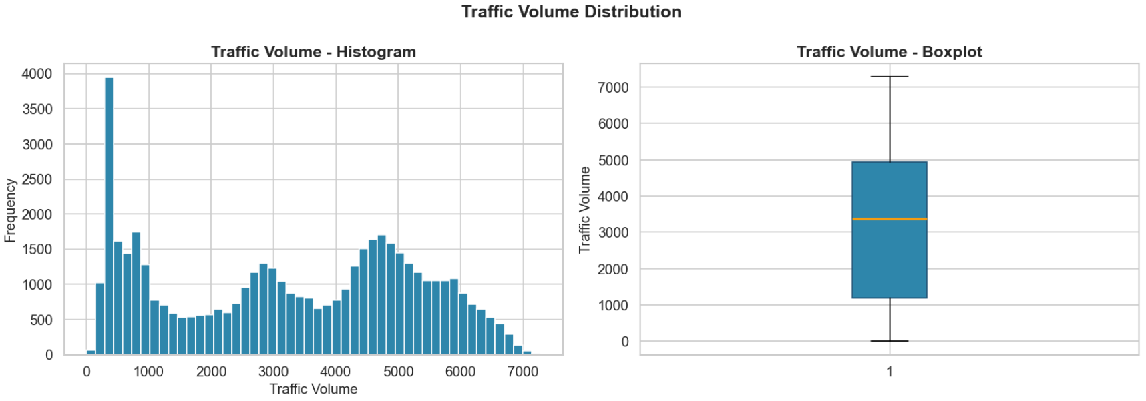
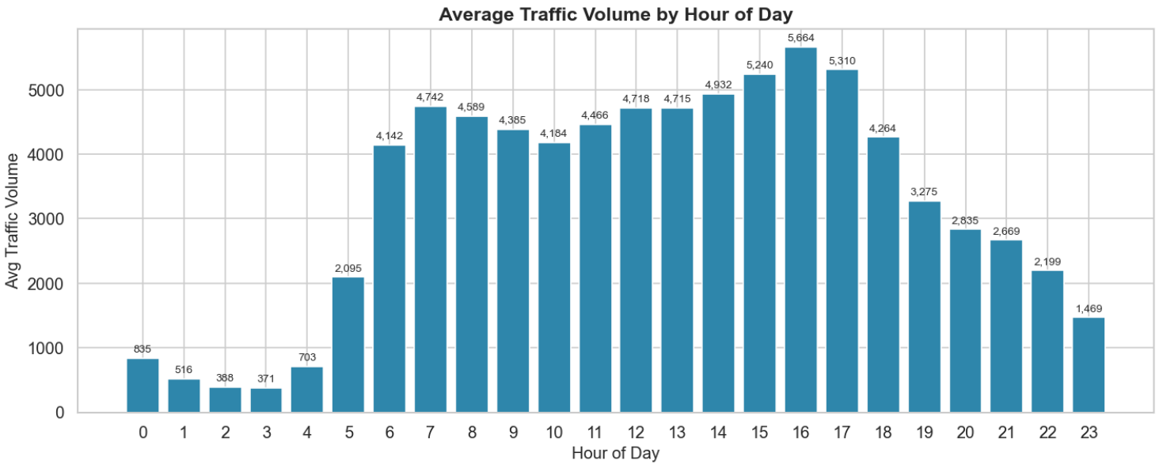
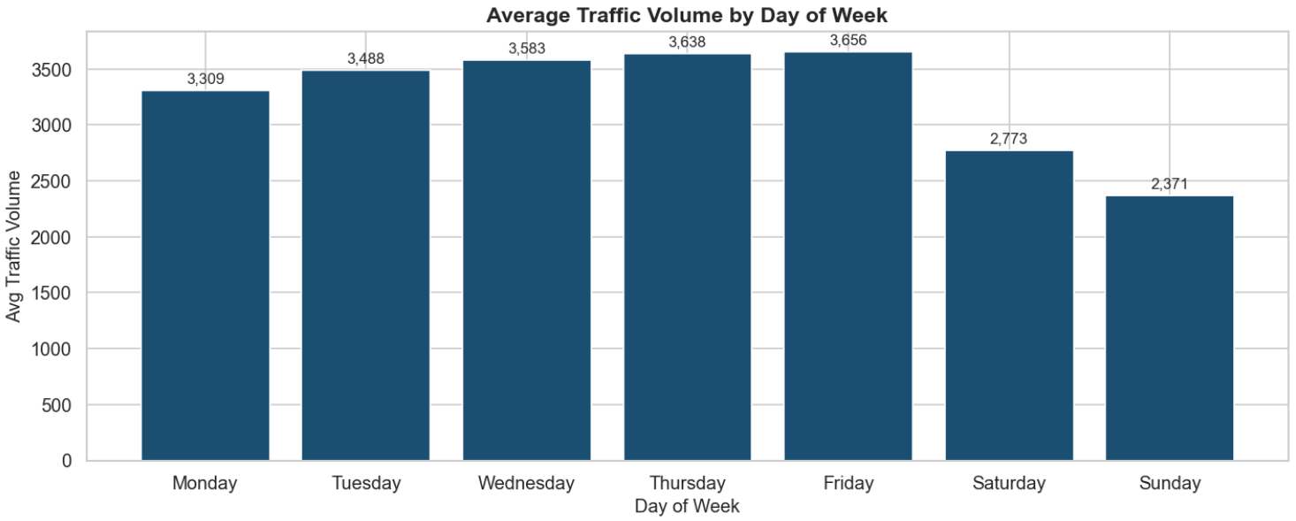

Slide 3
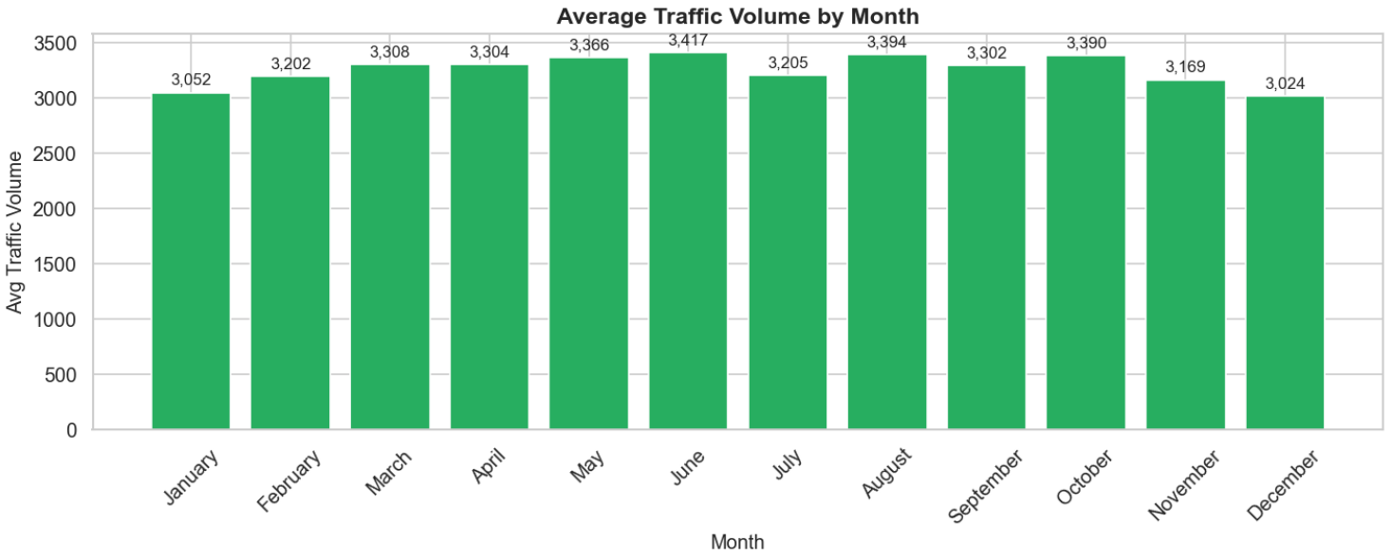
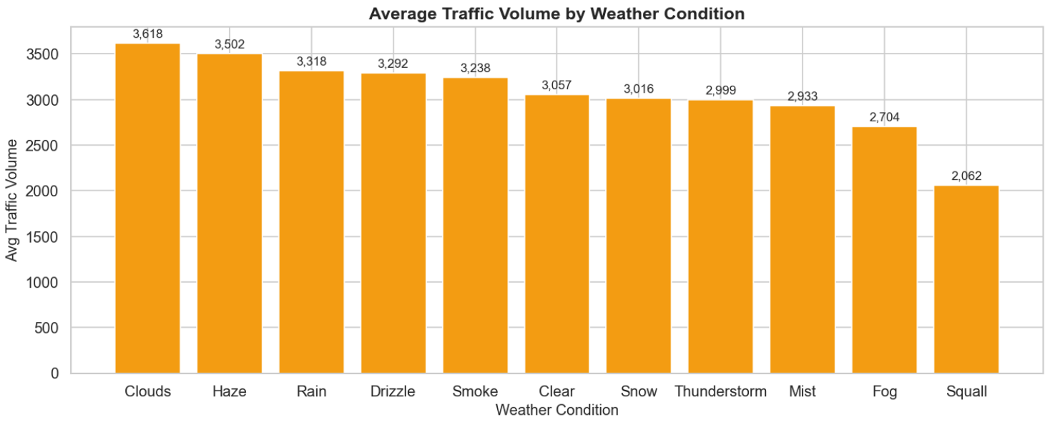
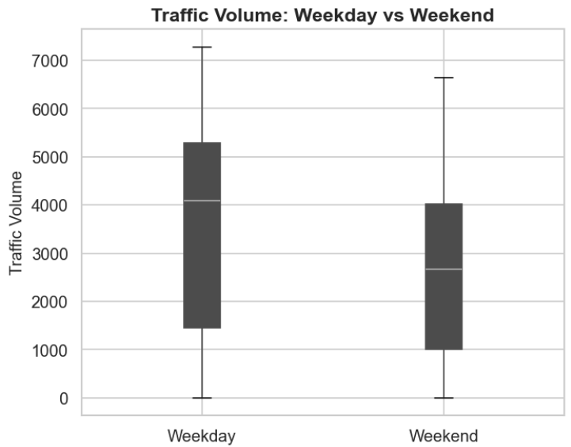
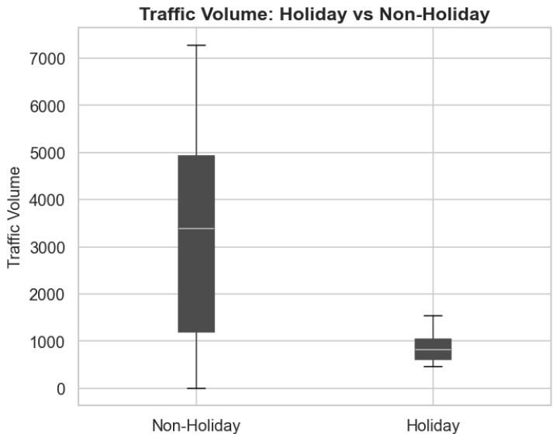

Slide 4
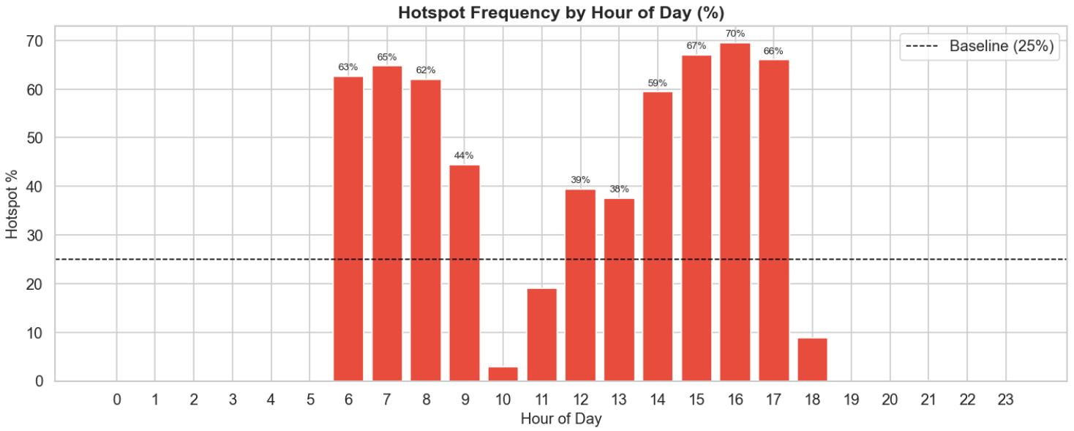
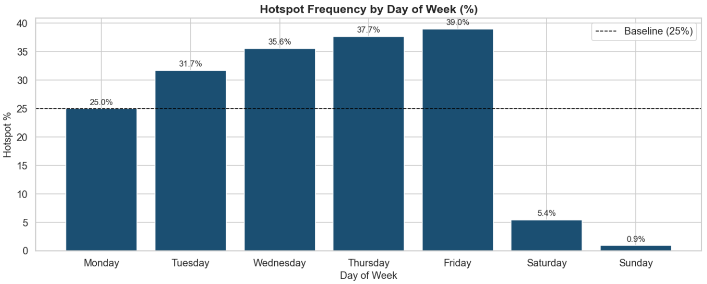
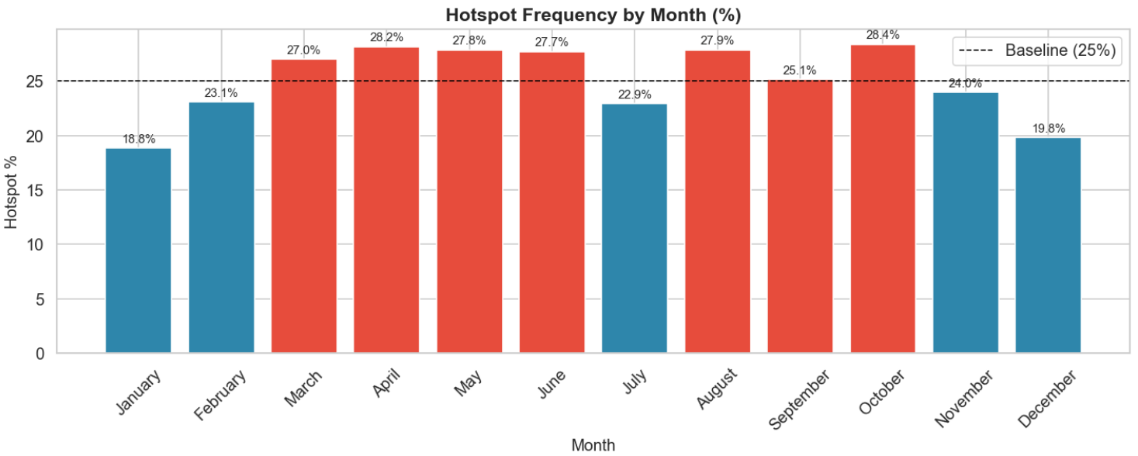
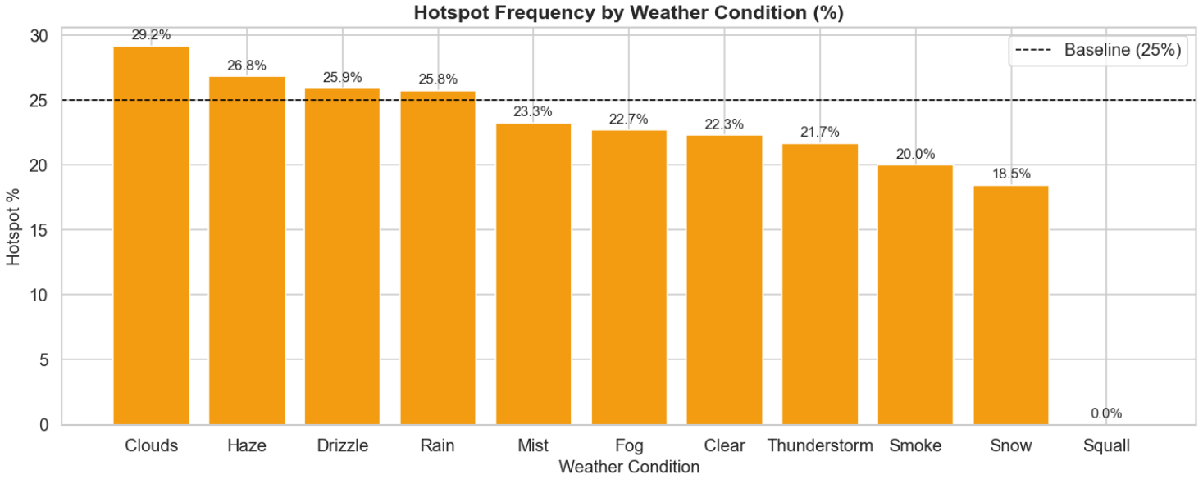

Slide 5
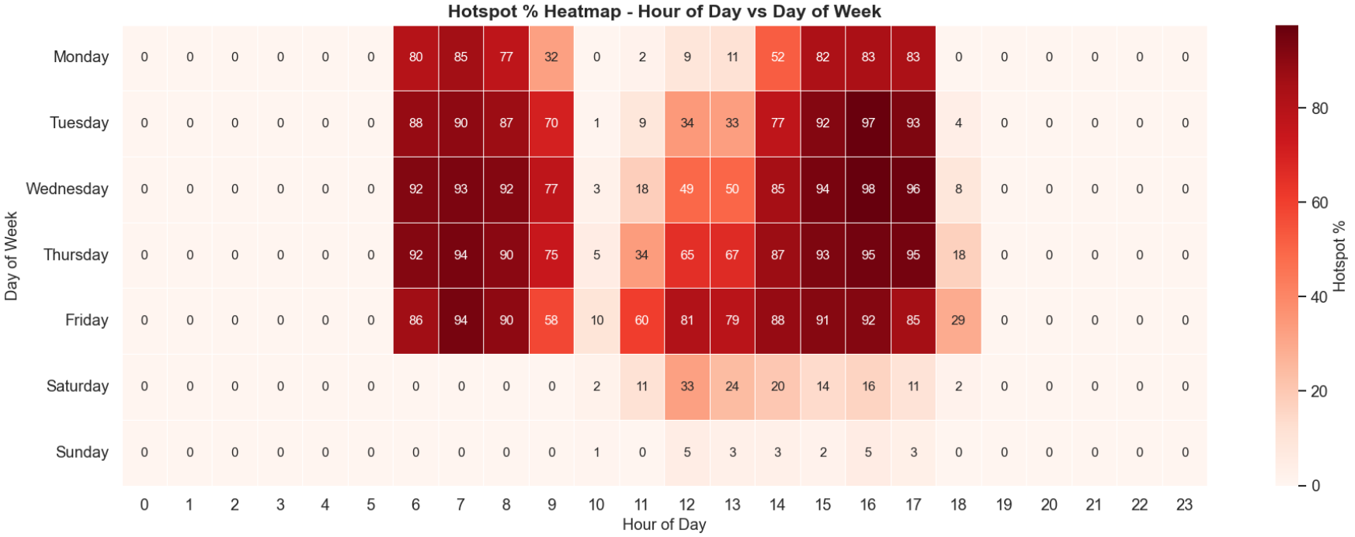
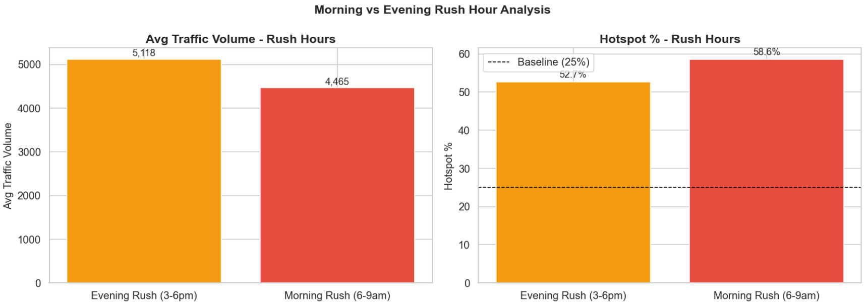
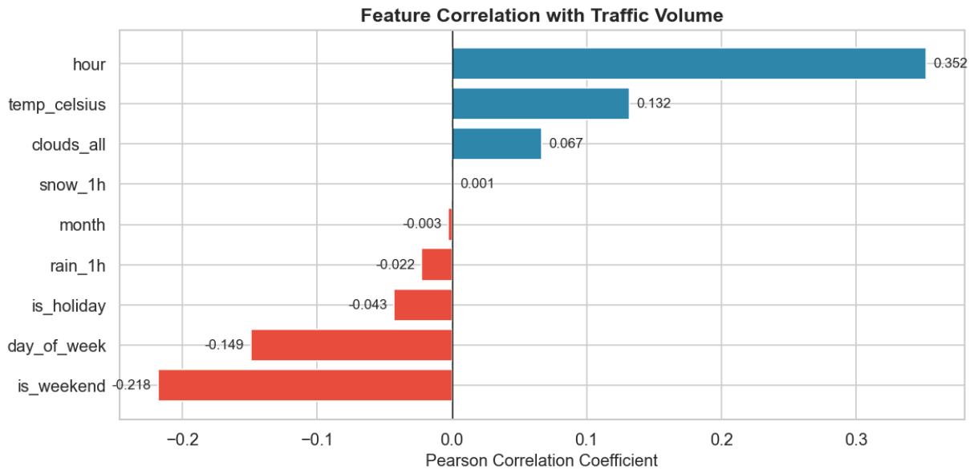

Slide 6
STATISTICAL VALIDATION & KEY FINDINGS
Hour of Day
Day of Week
Weather Condition
Weekday vs Weekend
Holiday vs Non-Holiday
Kruskal-Wallis
Kruskal-Wallis
Kruskal-Wallis
Mann-Whitney U
Mann-Whitney U
H = 36,616
H = 2,782
H = 888
U = 304M
U = 561K
p < 0.001
p < 0.001
p < 0.001
p < 0.001
p < 0.001
✓ Significant
✓ Significant
✓ Significant
✓ Significant
✓ Significant
4 PM
Friday
Oct
r=0.35
865
#1 Danger Hour
Riskiest Day
Riskiest Month
Top Predictor
Holiday Traffic
70% hotspot rate
39% hotspot rate
28.4% hotspot
Hour of Day
vs 3,263 non-hol.
All 5 tests: p < 0.05 · Findings statistically reliable across 48,176 hourly records (2012-2018)

Slide 7
KEY FINDINGS & RECOMMENDATIONS
HOUR OF DAY
DAY OF WEEK
4 PM is the #1 Danger Hour
Risk Builds Through the Week
Peak hotspot rate of 70% at 4 PM (avg 5,664 vehicles). Morning rush reaches 65% at 7 AM. Safe window exists between 9-11 AM. Hour of day is the strongest predictor (r = 0.352).
Friday carries the highest risk (39% hotspot). Risk progressively builds Mon→Fri (25%→39%). Weekends are nearly safe: Saturday 5.4%, Sunday just 0.9%. Weekday avg 3,533 vs weekend 2,572 vehicles.
MONTH & WEATHER
RECOMMENDATIONS
October Peaks, Winter Drops
Data-Driven Operational Actions
October = highest risk month (28.4%). January = lowest (18.8%). Cloudy and drizzly days are MORE dangerous than clear days (29.2% vs 22.3%). Heavy snow actually reduces traffic volume.
Concentrate patrols Tue-Fri, 6-9 AM & 3-6 PM. Schedule road maintenance between 9-11 AM or Saturday mornings. Pre-activate variable speed signs at 5:45 AM and 1:45 PM on weekdays.
All 5 statistical tests confirmed: p < 0.05 · 6 years of stable patterns, reliable for long-term city planning decisions

